Slide 1
ACQUISITION AND TRANSMISSION OF TB DRUG RESISTANCE IN CHINA
Fang Zhang
Simon Fraser University
July 20th, 2016

Slide 2
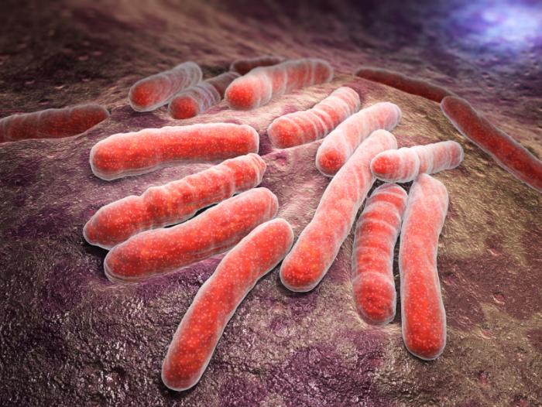
Tuberculosis(TB)
Human TB is an infectious disease usually caused by the bacterium Mycobacterium tuberculosis (MTB).
From: www.medicalnewstoday.com
From:
www.medicalnewstoday.com
From:
www.medicalnewstoday.com
Tuberculosis (TB)
Tuberculosis (TB)
• 9 million people developed TB and 1.5 million died from TB
• 9 million people developed TB and 1.5 million died from TB
worldwide in 2013.
worldwide in 2013.
• Efficient human-to-human transmission by aerosol route.
• Efficient human-to-human transmission by aerosol route.
• Effective treatment and control of TB are complicated by
• Effective treatment and control of TB are complicated by
the emergence and spread of drug-resistant, multidrug-
the emergence and spread of drug-resistant, multidrug-
resistant (MDR) and extensively drug-resistant (XDR) TB.
resistant (MDR) and extensively drug-resistant (XDR) TB.
Drug-resistant strains of TB
Drug-resistant strains of TB
• Isoniazid, rifampin, ethambutol and streptomycin are first-
• Isoniazid, rifampin, ethambutol and streptomycin are first-
line antituberculosis drugs.
line antituberculosis drugs.
• Ofloxacin and kanamycin are the second-line drugs.
• Ofloxacin and kanamycin are the second-line drugs.
• MDR TB is defined as disease that is resistant to at least
• MDR TB is defined as disease that is resistant to at least
isoniazid and rifampin
isoniazid and rifampin
• XDR TB is defined as disease that is resistant to at least
• XDR TB is defined as disease that is resistant to at least
isoniazid, rifampin, ofloxacin and kanamycin.
isoniazid, rifampin, ofloxacin and kanamycin.
Drug-resistant strains of TB
Drug-resistant strains of TB
•
Resistance can arise from two different sources: acquisition
•
Resistance can arise from two different sources: acquisition
and transmission.
and transmission.
• When an initial drug-sensitive strain acquires a resistance
• When an initial drug-sensitive strain acquires a resistance
mutation is acquisition.
mutation is acquisition.
From:
evolution.berkeley.edu
From:
evolution.berkeley.edu
Drug-resistant strains of TB
Drug-resistant strains of TB
• When a host gets infected by an already resistant strain
• When a host gets infected by an already resistant strain
from another host is transmission.
from another host is transmission.
From:
www.eac.int
From:
www.eac.int
Project Goal and summer goals
Project Goal and summer goals
• Project goal is to estimate the contributions of acquisition
• Project goal is to estimate the contributions of acquisition
vs. transmission via a simulation study.
vs. transmission via a simulation study.
•
Summer goals:
•
Summer goals:
a. Call Single-nucleotide polymorphisms (SNPs) on TB
a. Call Single-nucleotide polymorphisms (SNPs) on TB
genomes for every sample in MALAWI dataset (1628
genomes for every sample in MALAWI dataset (1628
TB genome sequences) and analyze the SNPs.
TB genome sequences) and analyze the SNPs.
b. A precise plan for the simulations and their
b. A precise plan for the simulations and their
implementation.
implementation.
c. Improve the initial simulation pipeline and confront the
c. Improve the initial simulation pipeline and confront the
simulates results with real data.
simulates results with real data.
What is an SNP?
What is an SNP?
• A single nucleotide
• A single nucleotide
polymorphism (SNP) is a
polymorphism (SNP) is a
variation in a single
variation in a single
nucleotide that occurs at
nucleotide that occurs at
specific position in the
specific position in the
genome.
genome.
From: https://en.wikipedia.org/wiki/Single-nucleotide_polymorphism
From: https://en.wikipedia.org/wiki/Single-nucleotide_polymorphism
Call SNPs on TB genomes
Call SNPs on TB genomes
• TB genome sequence is consist of about 4.4 million
• TB genome sequence is consist of about 4.4 million
nucleotides.
nucleotides.
• Frequently used TB reference sequence is H37Rv released
• Frequently used TB reference sequence is H37Rv released
in 1998 by the Welcome Trust
Sanger
Institute.
in 1998 by the Welcome Trust
Sanger
Institute.
• Intuitively compare a TB sequence to reference H37Rv to
• Intuitively compare a TB sequence to reference H37Rv to
call SNPs.
call SNPs.
• However, things are more complicated.
• However, things are more complicated.
Call SNPs on TB genomes
Call SNPs on TB genomes
• Reference sequence is always in fasta format.
• Reference sequence is always in fasta format.
• Sequence to be analyzed is in fastq format (one or two
• Sequence to be analyzed is in fastq format (one or two
fastq files).
fastq files).
From wikipedia
From wikipedia
Fastq format for one read
Fastq format for one read
•
@ERR124634.1 HS27_07553:8:1101:1283:15577#73/1
•
@ERR124634.1 HS27_07553:8:1101:1283:15577#73/1
•
CGGCTATTTCGCGCAGGAGCACGANACGNTCGACAANNATG
•
CGGCTATTTCGCGCAGGAGCACGANACGNTCGACAANNATG
CNNNCNTNNGGNNNAACGTCCGGCACGCGNNACCGGATNC
CNNNCNTNNGGNNNAACGTCCGGCACGCGNNACCGGATNC
NNGCGAACAGGACCTGNGC
NNGCGAACAGGACCTGNGC
•+
•+
•
CBEDFJHKJJKJMGIHK?DIJKKL!HGJ!KKNKKOL!!JHHI!!!F!K!!LK!!!F
•
CBEDFJHKJJKJMGIHK?DIJKKL!HGJ!KKNKKOL!!JHHI!!!F!K!!LK!!!F
;KJKIKJJJ;KFLI!!HFJLJJ:!E!!JIIKJJJBHEIJKH!-4
;KJKIKJJJ;KFLI!!HFJLJJ:!E!!JIIKJJJBHEIJKH!-4
Pipeline for calling SNPs
Pipeline for calling SNPs
1.
Index reference file with BWA index command.
1.
Index reference file with BWA index command.
2.
Map fastq files onto reference genome with BWA mem
2.
Map fastq files onto reference genome with BWA mem
command generating a SAM file.
command generating a SAM file.
3.
Transfer SAM file into BAM file.
3.
Transfer SAM file into BAM file.
4.
Sort the BAM from name order into coordinate order.
4.
Sort the BAM from name order into coordinate order.
5.
Call SNPs using samtools mpileup command.
5.
Call SNPs using samtools mpileup command.
6.
Call SNPs using GATK UnifiedGenotyper command.
6.
Call SNPs using GATK UnifiedGenotyper command.
7.
Intersect the two SNPs sets.
7.
Intersect the two SNPs sets.
Simulation
Simulation
• The process of simulation is below:
• The process of simulation is below:
1.
Simulate
an initial population (possibly using
1.
Simulate
an initial population (possibly using
the ancestors of the 4 lineages in Malawi as
the ancestors of the 4 lineages in Malawi as
the starting point)
the starting point)
2.
Model its evolution in time using discrete
2.
Model its evolution in time using discrete
events, such as mutation, transmission, and
events, such as mutation, transmission, and
resistance acquisition during treatment; after
resistance acquisition during treatment; after
a chosen time horizon, sample a random
a chosen time horizon, sample a random
fraction of the strains
fraction of the strains
Simulation
Simulation
3.
Repeat step 2 for a number of time horizons
3.
Repeat step 2 for a number of time horizons
and sampling fractions, as well as enough
and sampling fractions, as well as enough
times for each setting to get a distribution.
times for each setting to get a distribution.
4.
Use these simulated data as the basis of an
4.
Use these simulated data as the basis of an
evaluation of any classification algorithm.
evaluation of any classification algorithm.
Details of Simulation Process
Details of Simulation Process
1.
Download the Malawi data.
1.
Download the Malawi data.
2.
Reconstruct the ancestor of each linage by using phylogenetics with tools like
2.
Reconstruct the ancestor of each linage by using phylogenetics with tools like
Phylip, PAML and PAUL.
Phylip, PAML and PAUL.
3.
Generate a list of events:
3.
Generate a list of events:
a.
n1 mutation (n1 = m
n
µ
τ ), where µ is mutation rate and τ is time
∗
∗
∗
a.
n1 mutation (n1 = m
n
µ
τ ), where µ is mutation rate and τ is time
∗
∗
∗
span.
span.
b.
n2 transmission (n2 = m
β
τ ), where β is contact/reinfection rate and
∗
∗
b.
n2 transmission (n2 = m
β
τ ), where β is contact/reinfection rate and
∗
∗
τ is time span.
τ is time span.
c.
n3 resistance acquisition (n3 = α
P
P
τ ), where α is rate of
∗
∗
∗
T
R
c.
n3 resistance acquisition (n3 = α
P
P
τ ), where α is rate of
∗
∗
∗
breakdown, P
is probability of seeking for treatment, P
is resistance
T
R
T
R
breakdown, P
is probability of seeking for treatment, P
is resistance
rate and τ is time span.
T
R
rate and τ is time span.
d.
n4 death/removal γ
τ , where γ is rate of death/removal and τ is time
∗
d.
n4 death/removal γ
τ , where γ is rate of death/removal and τ is time
∗
span.
span.
N = n1 + n2 + n3 + n4, total events
N = n1 + n2 + n3 + n4, total events
Details of Simulation Process
Details of Simulation Process
4.
Produce the events and make changes in the matrices.
4.
Produce the events and make changes in the matrices.
a. decide which event, P[mutation] = n1/N etc.
a. decide which event, P[mutation] = n1/N etc.
b. decide what patient/strain it applies to (random)
b. decide what patient/strain it applies to (random)
c. mutation: select patient
and SNP
.
i
k
c. mutation: select patient
and SNP
.
i
k
d. transmission: from i to j, replace strain j by strain i
d. transmission: from i to j, replace strain j by strain i
and transmission overrules acquisition.
and transmission overrules acquisition.
e. acquisition: like mutation but k has to be a resistant
e. acquisition: like mutation but k has to be a resistant
SNP.
SNP.
f. death/removal: delete the column of the matrices.
f. death/removal: delete the column of the matrices.
5.
sampling: all alive patients, probability = κ
5.
sampling: all alive patients, probability = κ

Slide 3
Tuberculosis(TB)
9 million people developed TB and 1.5 million died from TB worldwide in 2013.
Efficient human-to-human transmission by aerosol route.
Effective treatment and control of TB are complicated by the emergence and spread of drug-resistant, multidrugresistant (MDR) and extensively drug-resistant (XDR) TB.

Slide 4
Drug-resistant strains of TB
Isoniazid, rifampin, ethambutol and streptomycin are first-line anti-tuberculosis drugs.
Ofloxacin and kanamycin are the second-line drugs.
Linezolid is one of the third line drugs.
MDR TB is defined as disease that is resistant to at least isoniazid and rifampin.
XDR TB is defined as disease that is resistant to at least isoniazid, rifampin, ofloxacin and kanamycin.

Slide 5
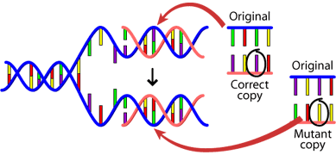
Drug-resistant strains of TB
Resistance can arise from two different sources: acquisition and transmission.
When an initial drug-sensitive strain acquires a resistance mutation is acquisition.

Slide 6
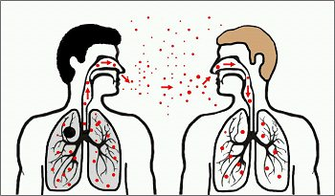
Drug-resistant strains of TB
When a host gets infected by an already resistant strain from another host is transmission.

Slide 7
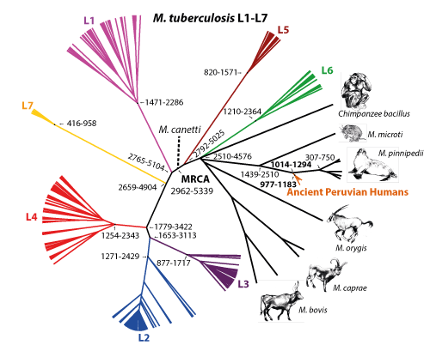
Evolution of TB
The lineages may vary in propensity in transit and cause disease [1].

Slide 8
Lineage 2 (Beijing)
Strains from the Beijing lineage have been associated with large MDR tuberculosis outbreaks elsewhere.
appear to be rapidly expanding in population size in settings with contrasting tuberculosis incidence levels.
possess selective advantages in comparison to strains from other Mycobacterium tuberculosis complex (MTBC) lineages, comprising an increased capacity to acquire drug resistance.
increase transmissibility, hypervirulence and/or more rapid progression to disease after infection.

Slide 9
Project goal
Project goal is to estimate the contributions of acquisition vs. transmission via a simulation study.

Slide 10
Beijing lineage data set
110 MTBC Beijing isolates (29 countries) for whole genome sequencing selected from 4,987 isolates from 99 countries [2].
154 sequences in total, because 34 isolates have 2 or more sequences.
For these 34 multi-sequenced isolates, sequence with highest (higher) average depth is selected (sequences are combined if their average depth are lower than 20).
6 sequences are removed because short reads. (All the reads are shorter than 100)
104 sequences are left.

Slide 11
Call SNPs on TB genomes
Call SNPs for each isolate to built a phylogenetic tree in order to find a common ancestor for simulation.
TB genome sequence is consist of about 4.4 million nucleotides.
Frequently used TB reference sequence is H37Rv (GenBank: AL123456.3) [3] released in 1998 by the Welcome Trust Sanger Institute.

Slide 12
Difficulties in calling SNPs
Experiments reproducibility [4]
Bwa mem as mapper, GATK unifiedgenotype and samtools mpileup as SNPs callers.
Bwa mem as mapper, GATK unifiedgenotype, samtools mpileup and FreeBayes as callers.
mrFast as mapper, GATK unifiedgenotype and samtools mpileup as SNPs callers.

Slide 13
Difficulties in calling SNPs
Remove SNPs in repetitive regions [5].
Remove resistant SNPs [6].
The main reason is to exclude homoplastic positions for the phylogeny.
Remove SNPs depth lower than 10.
Remove isolates that has more than 10% SNPs whose depth are lower than 10.
90 isolates left and 6403 SNPs in total.

Slide 14
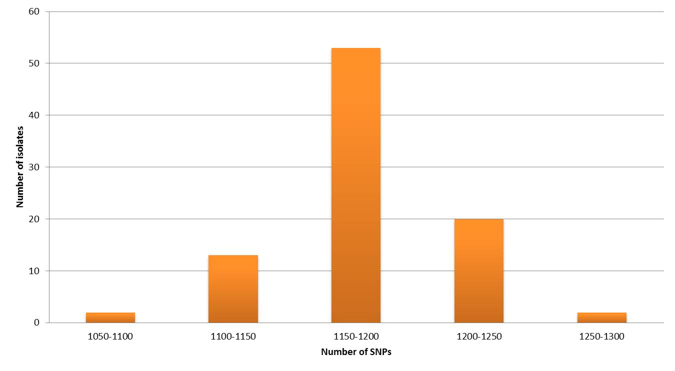
Histogram of SNPs detected for 90 isolates.

Slide 15
Constructing the phylogenetic trees
Using the SNPs, infer the best fit model of nucleotide substitution using jModelTest
Construct the phylogenetic tree:
Neighbor-joining (MEGA)
Maximum Likelihood (MEGA)
Bayesian Inference (BEAST 2)
Comparing the three trees by finding the normalized Robinson-Foulds distance between each pair.
Based on the Bayesian phylogenetic which was the best among the three trees, nodes with posterior lower than 0.7 were collapsed.

Slide 16
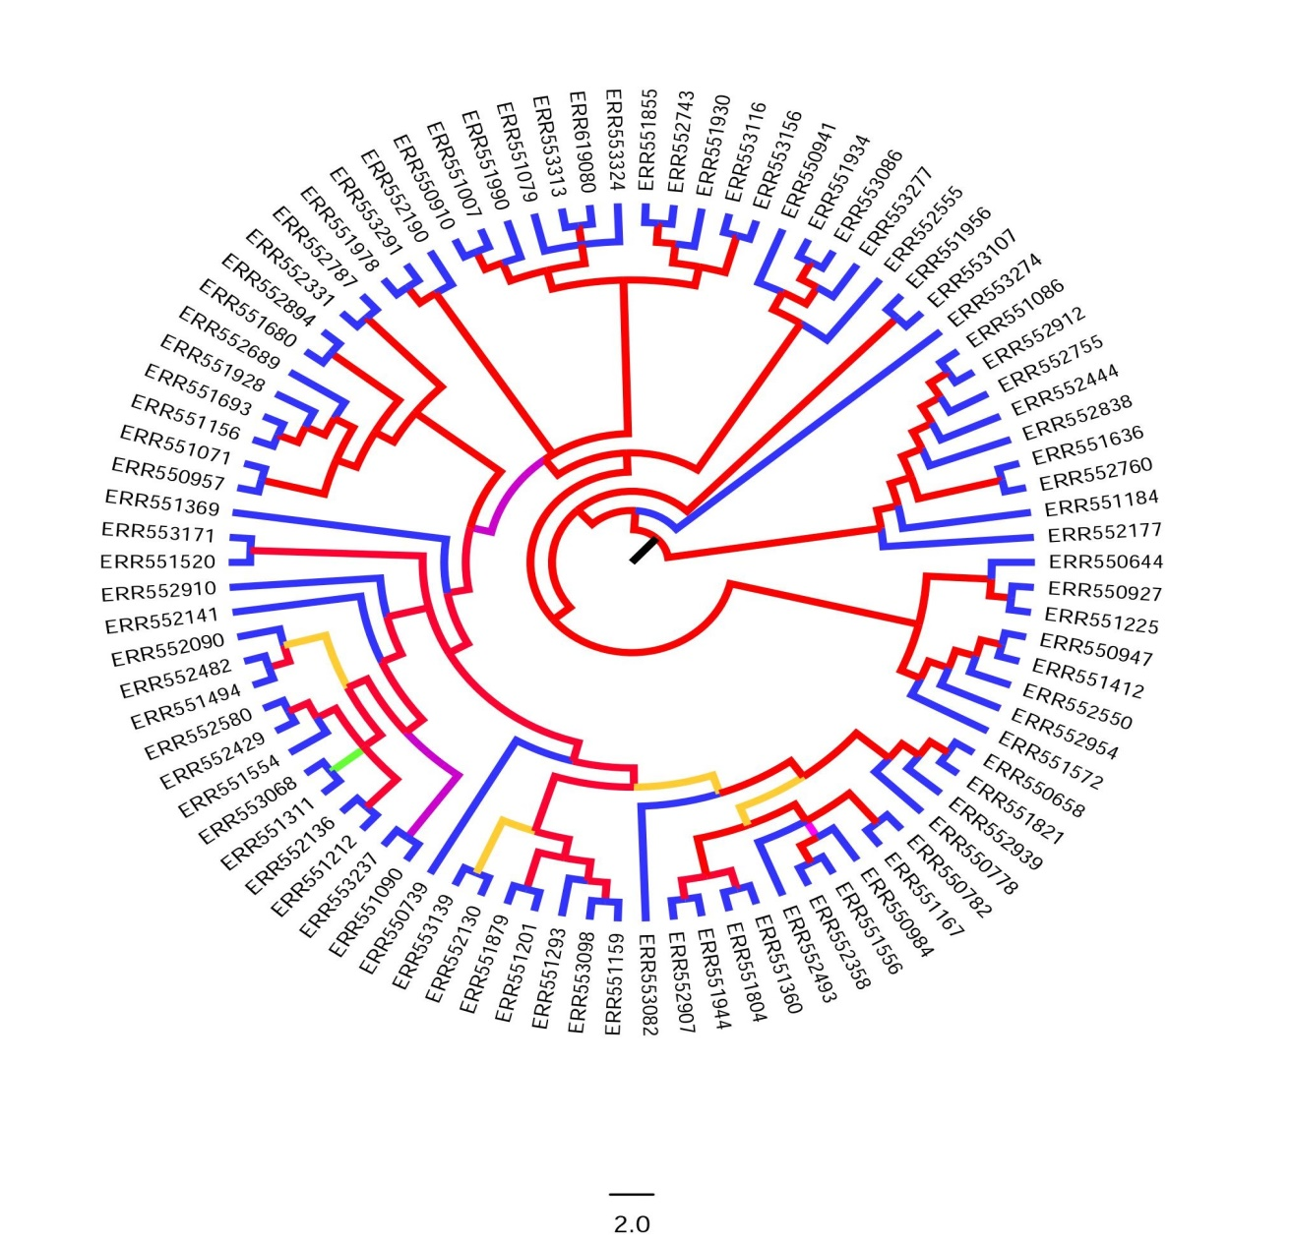
Bayesian Phylogenetic tree of 90 isolates constructed by BEAST2.

Slide 17
Ancestral Sequence Reconstruction
Based on the collapsed Bayesian inference phylogenetic tree, reconstruction of the ancestral genome sequence was obtained utilizing the program BASEML of the PAML package
This ancestral sequence was then used as the original sequence in the simulation study.

Slide 18
Simulation
The process of simulation is below:
Simulate the development of the single ancestor TB sequence to an initial population (Mutate once for each generation).
Model its evolution in time using discrete events, such as mutation, transmission, resistance acquisition and removal; after a chosen time horizon, sample a random fraction of the strains.

Slide 19
Simulation
The process of simulation is below:
Repeat step 2 for a number of time horizons and sampling fractions, as well as enough times for each setting to get a distribution.
Use these simulated data as the basis of an evaluation of any classification algorithm.

Slide 20
Details of Simulation Process
Download the Beijing data.
Reconstruct the ancestor of each linage by using phylogenetics tools.
Generate a list of events:
n₁ mutation (n= m ∗ μ ∗ τ ), where μ is mutation rate and τ is time span.
n₂ transmission (n₂ = m ∗ β ∗ τ ), where β is contact/reinfection rate and τ is time span.
n₃ resistance acquisition (n₃ = m ∗ α ∗ τ ), where α is rate of resistance acquisition and τ is time span.
n₄ death/removal m ∗ γ ∗ τ , where γ is rate of death/removal and τ is time span.
N = n₁ + n₂ + n₃ + n₄, total events

Slide 21
Details of Simulation Process
Produce the events and make changes in the matrices.
decide which event, P[mutation] = n₁/N etc.
Randomly decide which unremoved patient/strain it applies to
mutation: select patient i and SNP k. No mutation at this position anymore and cannot mutate back.
transmission: from i to j, replace strain j by strain i and acquisition overrules transmission. I and j should both be unremoved.
acquisition: like mutation but k has to be a resistant SNP.
death/removal: mark this sequence as removal.
sampling: all alive patients, probability = κ

Slide 22
Simulation example
Develop
Breakout
mutation
resistant
resistance aquisition
transmission
removed

Slide 23
Simulation Results
Run simulation for different combination of parameters.
For each simulation result, sample 20 times to get average results.
Statistics on resistant patients, resistant patients caused by transmission, resistant patients caused by acquisition and resistant patients with multiple events (transmission and acquisition).

Slide 24
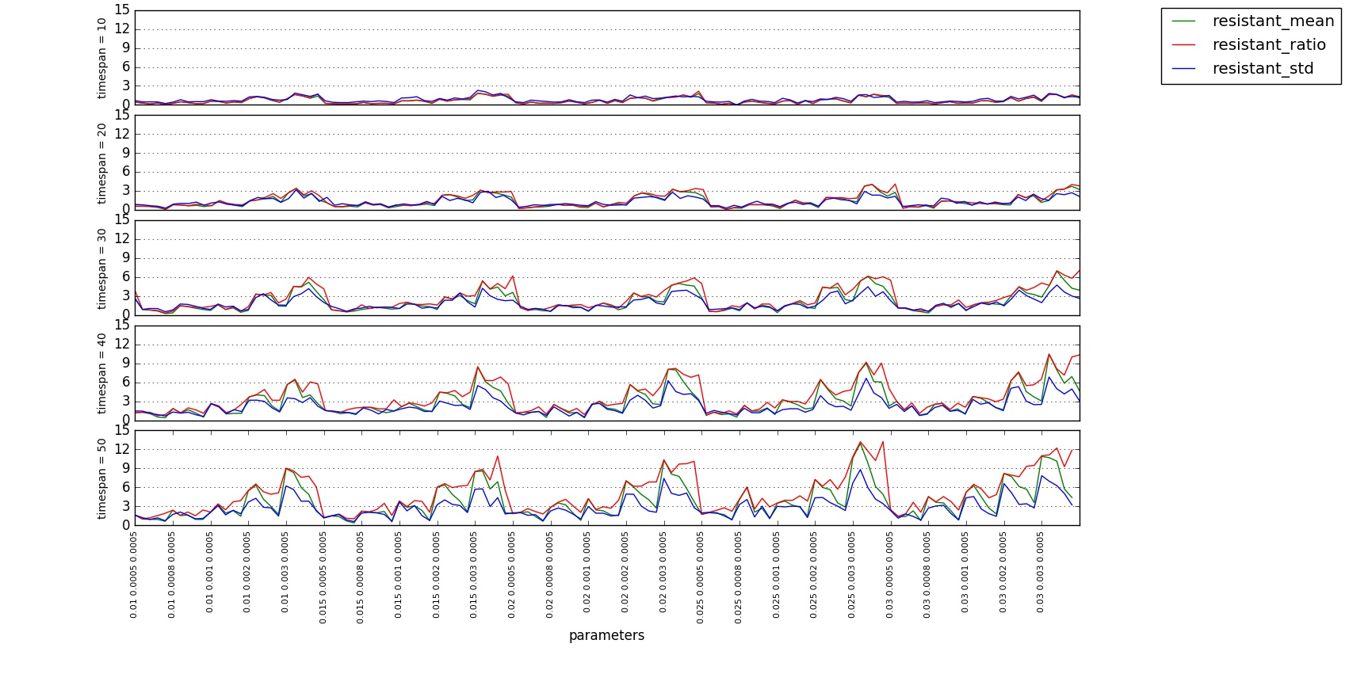
Simulation Results

Slide 25
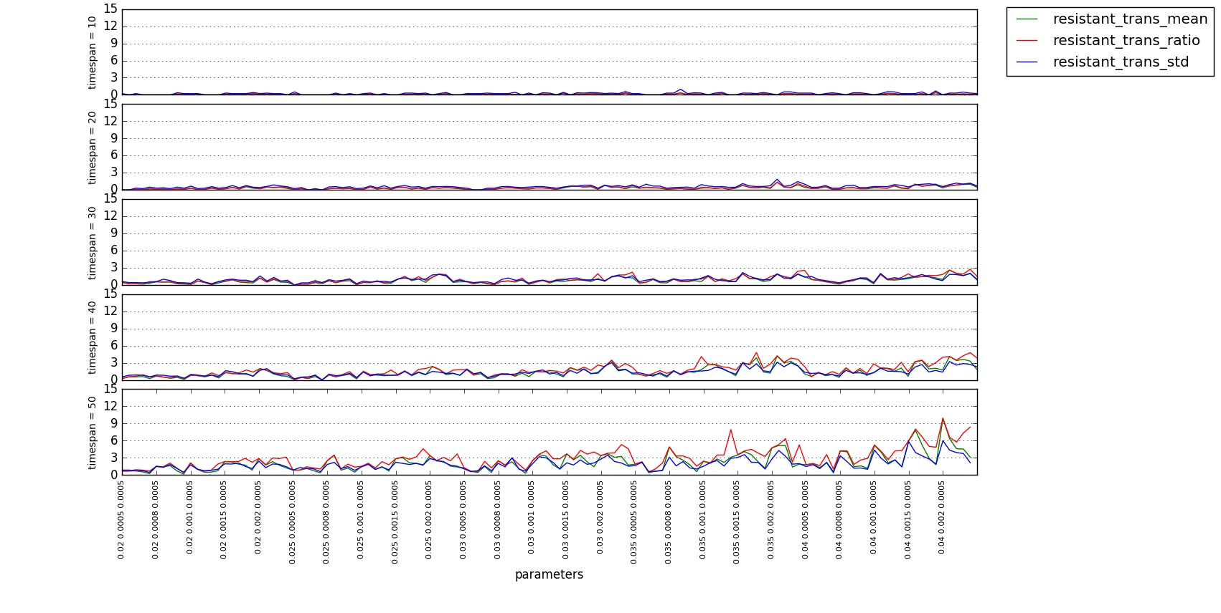
Simulation Results

Slide 26
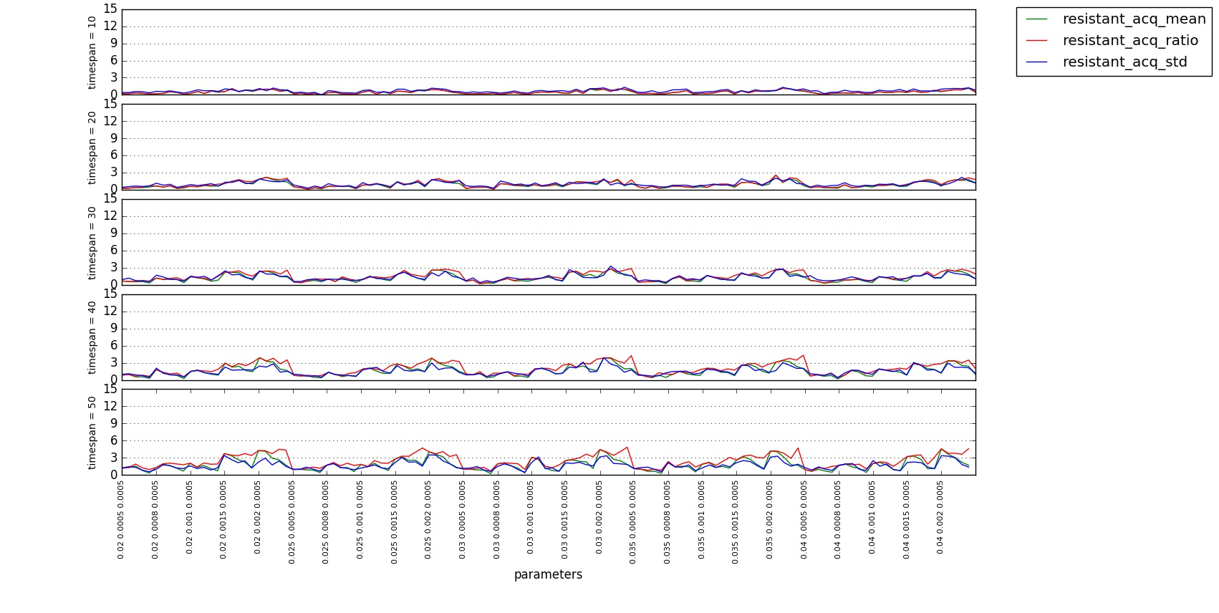
Simulation Results

Slide 27
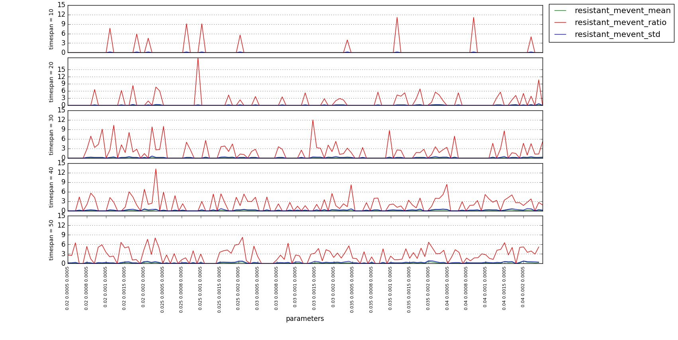
Simulation Results

Slide 28
Simulation Results
In reality, resistant patients ratio should be around 10%.
868 combinations of parameters that can make resistant patients ratio around 10% were recorded.

Slide 29
Reference
Guerra-Assunção J A, Crampin A C, Houben R, et al. Large-scale whole genome sequencing of M. tuberculosis provides insights into transmission in a high prevalence area[J]. Elife, 2015, 4: e05166.
Merker M, Blin C, Mona S, et al. Evolutionary history and global spread of the Mycobacterium tuberculosis Beijing lineage[J]. Nature genetics, 2015, 47(3): 242-249.
Cole S T, Brosch R, Parkhill J, et al. Deciphering the biology of Mycobacterium tuberculosis from the complete genome sequence[J]. Nature, 1998, 393(6685): 537-544.
Firtina C, Alkan C. On genomic repeats and reproducibility[J]. Bioinformatics, 2016: btw139.
Comas I, Chakravartti J, Small P M, et al. Human T cell epitopes of Mycobacterium tuberculosis are evolutionarily hyperconserved[J]. Nature genetics, 2010, 42(6): 498-503.
Feuerriegel S, Schleusener V, Beckert P, et al. PhyResSE: a web tool delineating Mycobacterium tuberculosis antibiotic resistance and lineage from whole-genome sequencing data[J]. Journal of clinical microbiology, 2015, 53(6): 1908-1914.

